Slide 1
Organization of Von-Neumann Machine (IAS Computer)
Computer Organization and Architecture
by
William Stallings

Slide 2
Architecture & Organization 1
Architecture
  It is those attributes visible to the programmer
    Instruction set
    Number of bits used for data representation
    I/O mechanisms
    Addressing techniques.
Organization
  It is how features are implemented (Transparent to the programmer)
    Control signals
    Interfaces
    Memory technology.

Slide 3
Organization of Von-Neumann Machine (IAS Computer)
Stored Program Concept
  says that the program is stored in the computer along with any relevant data.
Princeton Institute for Advanced Studies
  IAS
Completed 1952.
A stored program computer consists of a processing unit and an attached memory system.
Processing unit consists of data-path and control.
Data-path contains registers to hold data and functional units, such as arithmetic logic units and shifters, to operate on data.

Slide 4

Structure of Von Neumann Machine

Slide 5
Organization of Von-Neumann Machine (IAS Computer)
Basic elements of the stored-program computer
  A memory
    containing both data and instructions
  A calculating unit
    capable of performing both arithmetic and logical operations on the data
    operating on binary data
  A control unit
    which is interpreting instructions from memory and executing.
  Input and output equipment operated by control unit

Slide 6
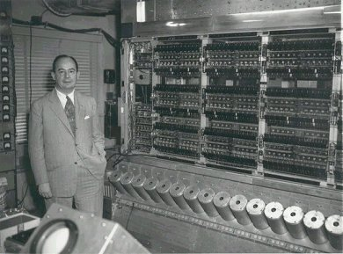
Dr. Von-Neuman with IAS machine

Slide 7
Memory of the IAS
1000 storage locations called words.
Each word 40 bits.
A word may contain:
  A numbers stored as 40 binary digits (bits) – sign bit + 39 bit value
  An instruction-pair.
  Each instruction:
    An opcode (8 bits)
    An address (12 bits) – designating one of the 1000 words in memory.

Slide 8
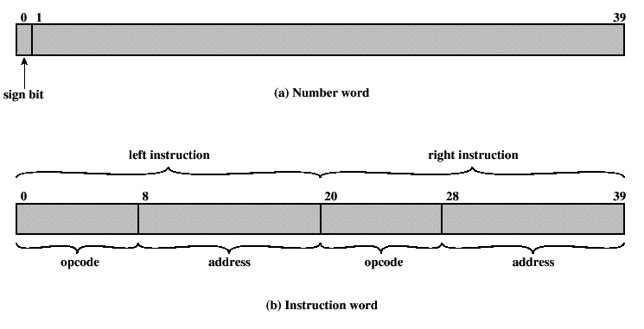
Memory of the IAS cont..

Slide 9

Von Neumann Machine

Slide 10
Von Neumann Machine
MBR: Memory Buffer Register
  contains the word to be stored in memory or just received from memory.
MAR: Memory Address Register
  specifies the address in memory of the word to be stored or retrieved.
IR: Instruction Register
  contains the 8-bit opcode currently being executed.
IBR: Instruction Buffer Register
  temporary store for RHS instruction from word in memory.
PC: Program Counter
  address of next instruction-pair to fetch from memory.
AC: Accumulator & MQ: Multiplier quotient
  holds operands and results of ALU ops.

Slide 11
Size of
AC –
MQ –
MBR –
IBR –
IR –
MAR –
PC –
40 bits
40 bits
40 bits
20 bits
8 bits
12 bits
12 bits

Slide 12
IAS Instructions
The IAS computer had a total of 21 instructions and grouped as follows:
  Data Transfer:
    Move data between memory and ALU registers or between ALU Registers.
  Unconditional branch:
    Control unit executes instruction in sequence from memory .
    This sequence can be changed by a branch instruction.
  Conditional Branch: depends on condition.
  Arithmetic:
    Operations performed by the ALU.
  Address modify:
    Address to be computed in the ALU and then inserted into instructions stored in memory.

Slide 13
Data Transfer Instructions
Instruction Type | Opcode | Symbolic Representation | Description
Data transfer | 00001010 | LOAD MQ | AC‹― MQ
 | 00001001 | LOAD MQ M(X) | MQ‹― Memory (X)
 | 00100001 | STOR M(X) | Memory(X) ‹― AC
 | 00000001 | LOAD M(X) | AC ‹― Memory(X)
 | 00000010 | LOAD -M(X) | AC ‹― -M(X)
 | 00000011 | LOAD |M(X)| | AC ‹― Absolute of M(X)
 | 00000100 | LOAD -|M(X)| | AC ‹― Absolute of -M(X)

Slide 14
Unconditional Branch
Instruction Type | Opcode | Symbolic Representation | Description
Unconditional Branch | 00001101 | JUMP M(X,0:19) | Take next instruction from left half of M(x)
 | 00001110 | JUMP M(X,20:39) | Take the instruction from right half of M(x)

Slide 15
Conditional Branch
Instruction Type | Opcode | Symbolic Representation | Description
Conditional Branch | 00001111 | JUMP+ M(X,0:19) | If no. in AC is +ve take the next instruction from left half of M(X)
 | 00010000 | JUMP+ M(X,20:39) | If no. in the AC is +ve take next instruction from right half of M(X)

Slide 16
Arithmetic
Instruction Type | Opcode | Symbolic Representation | Description
Arithmetic | 00000101 | ADD M(X) | AC + M(X) AC ‹― result
 | 00000110 | SUB M(X) | AC - M(X) AC ‹― Result
 | 00001011 | MUL M(X) | Multiply M(X) by MQ AC ‹― MSB MQ ‹― LSB
 | 00001100 | DIV M(X) | Divide AC by MQ MQ ‹― quotient AC ‹― REMAINDER
 | 00010100 | LSH | Left shift 1 Bit position (Multiply AC by 2)
 | 00010101 | RSH | Shift Right bit one position (DIVIDE AC by 2)

Slide 17
Address modify
Instruction Type | Opcode | Symbolic Representation | Description
Address modify | 00010010 | STOR M(X,8:19) | Replace left address field of M(X) by 12 rightmost bits of AC
 | 00010011 | STOR M(X,28:39) | Replace right address field of M(X) by 12 rightmost bits of AC

Slide 18
AC = 7
AC = 3
MEMORY
1. LOAD M(X) 500, ADD M(X) 501
2. STOR M(X) 500, (Other Ins)
.....
3
4
AC
MQ
500
MBR = 4
LOAD M(X)
MBR
MBR = 3
500
ADD M(X) 501
(Other Ins)
STOR M(X)
PC
1
2
MAR
1
500
501
2
500
MBR
LOAD M(X) 500, ADD M(X) 501
3
4
STOR M(X) 500, (Other Ins)
IR
LOAD M(X)
ADD M(X)
STOR M(X)
IBR
ADD M(X) 501
(Other Ins)
AC
3
501
PC = 2
7
IBR
PC = 1
Add M(X)
Mar ← PC
MAR ←PC
3
LOAD M(X) 500, ADD M(X) 501
4
IR
MAR = 2
STOR M(X) 500, (Other Ins)
MAR = 501
MAR = 1
MAR = 500
MAR =500
add = 501
add = 1
add = 500
add = 2

